Slide 1
Agile Foundations with Scrum
Session 1: Scrum Basics

Slide 2
Definition of Agile: The Manifesto
Manifesto for Agile Software Development
We are uncovering better ways of developing software by doing it and helping others do it.
Through this work we have come to value:
Individuals and interactions over processes and tools Working software over comprehensive documentation Customer collaboration over contract negotiation Responding to change over following a plan
That is, while there is value in the items on the right, we value the items on the left more.
Notes:
What is Agile is a question that gets asked a lot.
Agile is a buzz work that gets thrown around a lot.
At the core of all things agile is the Agile Manifesto.
If a practice, process, or tool can demonstrate that it holds true to all four of the agile values, we can confidently call it agile.

Slide 3
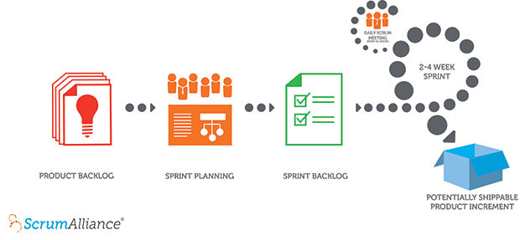
The Scrum Flow
Notes:
A product owner creates a prioritized wish list called a product backlog.
During sprint planning, the team pulls a small chunk from the top of that wish list, a sprint backlog, and decides how to implement those pieces.
The team has a certain amount of time — a sprint (usually two to four weeks) — to complete its work, but it meets each day to assess its progress (daily Scrum).
Along the way, the ScrumMaster keeps the team focused on its goal.
At the end of the sprint, the work should be potentially shippable: ready to hand to a customer, put on a store shelf, or show to a stakeholder.
The sprint ends with a sprint review and retrospective.
As the next sprint begins, the team chooses another chunk of the product backlog and begins working again.

Slide 4
Timebox
A timebox is a previously agreed period of time during which a person or a team works steadily towards completion of some goal. Rather than allow work to continue until the goal is reached, and evaluating the time taken, the timebox approach consists of stopping work when the time limit is reached and evaluating what was accomplished.
- Agile Alliance
(www.agilealliance.org)
A constraint used in planning and time management.
A limited amount of time described in terms of duration. E.g: 2 hour time box.

Slide 5
Iteration
Is a timebox during which a progress toward a clearly defined goal is made.
In scrum, an iteration is a Sprint.
In this class and iteration is a session.

Slide 6
Training Iteration
Goal for Session 1:
Participants will understand:
The definition of Agile.
The basic dynamics of a Scrum team.
The value of the rules of Scrum.
Notes:
The Outstanding Stories from last week
Priorities for this week
Review of T-Shirt Sizes: SMALL – 5 min or less, Medium ~ 10 min, Large ~ 20 min

Slide 7
Sprints
A time box during which the team will build, test, and deliver to the product owner a unit of work they have identified from the Product Backlog.

Slide 8
Definition of Done
A predefined set of criteria that must be true before a task or story can be determined as done.
Must be explicit and known by the entire team.
Can include readiness for handoff to a downstream team, promotion to a specific environment, etc.
Must include all acceptance criteria defined by the Product Owner.

Slide 9
Max Sprint Duration
Sprints should be no longer in duration than 4 weeks.

Slide 10
Sprint Backlog Protected from Changes
It is not set in stone, but without protection, the sprint goal may be put at risk.
Sprint backlog is protected, not impervious (impervious would not be responsive to change).
Rules for modifying the sprint backlog should be public, familiar to the team, and explicit.

Slide 11
Hands on Exercise
Download a copy of the Sprint Schedule worksheet.
Create a schedule for a Scrum team.
Select a Sprint duration
Set a schedule for the Scrum events for the team.
Considerations:
What days does the sprint start and end on
Is there any lag time between sprints?
How long should our respective Scrum Events be?

Slide 12
1:50 PM - Retrospective
4 Quadrants Exercise:
On a sticky note write (1 item per sticky):
What went well or not well; suggestions and shout-outs
Place on the appropriate quadrant.

